Slide 1
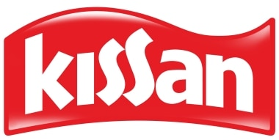
Comprehensive Digital Marketing
Project Work Of Kissan

Slide 2
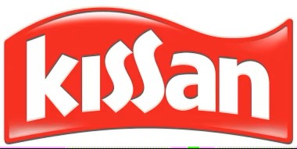
Part 1: Brand study, Competitor Analysis & Buyer’s/Audience’s Persona
Research Brand Identity: Study the brand's mission, values, vision, and unique selling propositions (USPs).
Introduction To The Brand:During the British era, trains passing through Punjab made a stop at a processing unit where farmers sold freshly picked fruits. Locals called this spot Kissan and from there on it became a household name. The UB group, under the Late Vittal Mallya then, acquired Kissan from Mitchell Bros. in the year 1950. In 1993, Kissan was acquired by Brooke Bond India and is now an integral part of Hindustan Unilever Limited (HUL).
Logo Of Brand :

Slide 3
Founder : The UB group, under the Late Vittal Mallya
Founded Year : 1950
Official Website : https://www.kissan.in/
Mission : Our mission is to provide wholesome and delicious food products that bring joy to people's lives while promoting health, sustainability, and community engagement. We are committed to sourcing high-quality ingredients and utilizing responsible farming practices to ensure the integrity of our products. Our aim is to create a positive impact on the well-being of individuals and the environment, while fostering meaningful connections with our consumers and the communities we serve.“
Values : quality, health and well-being , sustainability, transparency, community engagement ,innovation
USP : Kissan's USP should align with its target audience's preferences and needs. Conducting market research and understanding consumer insights will help identify the most compelling USP that resonates with the brand's customers and sets it apart from competitors.

Slide 4
Part 1: Brand study, Competitor Analysis & Buyer’s/Audience’s Persona
Analyze Brand Messaging :
Natural and Fresh: Kissan emphasizes the use of natural ingredients and freshness in its products. The brand messaging conveys a sense of quality and authenticity, assuring consumers that they are getting products made from real fruits and vegetables.
2.Tastes of Home: Kissan often evokes a sense of nostalgia and home-cooked flavors in its brand messaging. The brand positions its products as being reminiscent of homemade recipes and traditional flavors that consumers grew up with, creating an emotional connection.
3.Vibrant and Fun: Kissan's brand messaging often highlights the vibrant colors and fun aspects of its products. Whether it's the bright red of their ketchup or the colorful packaging of their jams, Kissan portrays its offerings as playful and enjoyable.

Slide 5
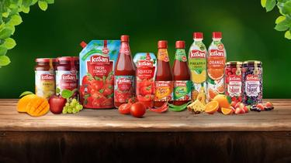
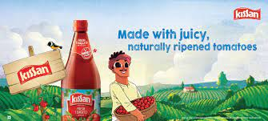
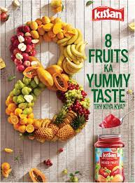
4.Family and Togetherness: Kissan's brand messaging often centers around the idea of family and togetherness. The brand positions its products as the perfect accompaniment to family meals and special moments, fostering a sense of connection and shared experiences.
5.Health and Nutrition: While Kissan primarily focuses on taste and flavor, the brand also emphasizes the nutritional aspect of its products. The brand messaging highlights the presence of essential vitamins and nutrients in their offerings, appealing to health-conscious consumers.

Slide 6
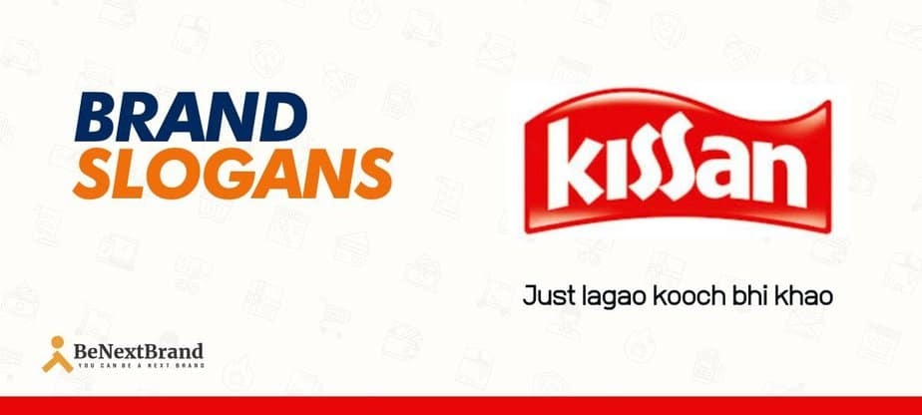
Examine the brand's tagline: 1.The goodness of real fruit in every jar of kissan
2.Just lagao kooch bhi khao
3.Ab pao fruits ka khatta meetha blast Kissan ke saath
4.Spread the flavour
5.Kissan jam’s law of appetitie

Slide 7
Part 1: Brand study, Competitor Analysis & Buyer’s/Audience’s Persona
Competitor Analysis: Select three competitors operating in the same industry or niche as the chosen brand, examine their USPs and online communication.
Competitor 1: Releaf – link : https://releaf.in/
USP : We believe in the power of human thoughts and the immense possibilities it can achieve.
Competitor 2: GrainCorp –link : https://www.graincorp.com.au/
USP : While our GrainCorp team is diverse, we each believe in our values to
Competitor 3: FoodLogiQ –link : https://www.foodlogiq.com/
USP : Qualities Your gourmet cuisine has been recognized with awards and reviews.

Slide 8
Part 1: Brand study, Competitor Analysis & Buyer’s/Audience’s Persona
Buyer's/Audience's Persona: Clearly define the target audience for the chosen brand. Consider demographics, psychographics, behaviors, and interests.
Target audience for the Kissan brand
1. Families and Parents: Kissan primarily targets families and parents who are responsible for purchasing and preparing meals for their households. The brand focuses on appealing to parents who want to provide nutritious and flavorful options for their children and loved ones.
2.Children and Young Consumers: Kissan also targets children and young consumers who enjoy the taste of their products. The brand messaging often highlights the fun and enjoyable aspects of Kissan's jams, ketchups, and sauces, appealing to the younger audience.
3.Home Cooks and Food Enthusiasts: Kissan aims to attract home cooks and food enthusiasts who value quality ingredients and want to create delicious meals. These individuals appreciate the versatility and flavor profiles offered by Kissan's range of products.

Slide 9
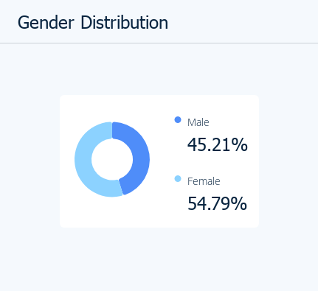
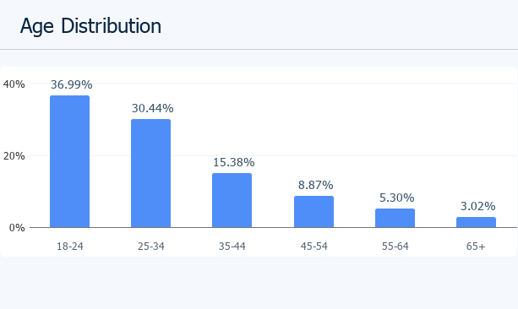
4.Health-conscious Consumers: Kissan caters to health-conscious consumers who seek products made from natural ingredients and are mindful of their nutritional choices. The brand often emphasizes the use of real fruits and vegetables, appealing to individuals who prioritize healthier options.
Demographic :

Slide 10
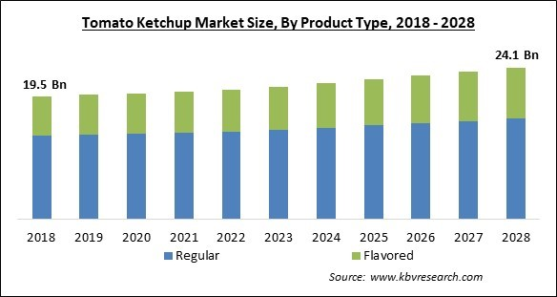
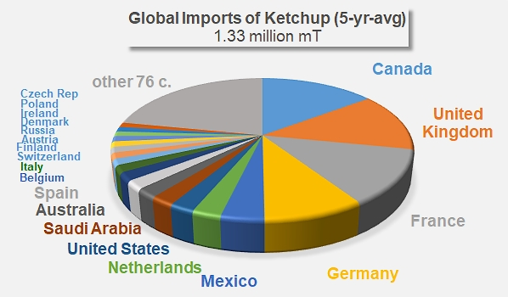
Psychographic : Psychographic is how marketers learn to position their products so that compatible customers can “discover” them. It's how brands find the right customer match based on customer attitudes and lifestyles. You may not realise it, but psychographic segmentation is the primary driving factor in our life.

Slide 11
Part 2: SEO & Keyword Research
SEO Audit: Do an SEO audit of the brands website
Keyword Research: Define Research Objectives, Brainstorm Seed Keywords, Utilize Keyword Research Tools (SEMrush or Moz Keyword Explorer),Analyze Competitor Keywords, Long-tail Keyword Exploration (specific, longer phrases) that align with the research objectives and have lower competition but higher conversion potential.
On page Optimization: Meta Tag optimization & content optimization
Reflect on the process of conducting keyword research and the SEO recommendations provided.
Document the challenges faced during the research and analysis phase, as well as the key insights gained from the keyword research process.

Slide 12
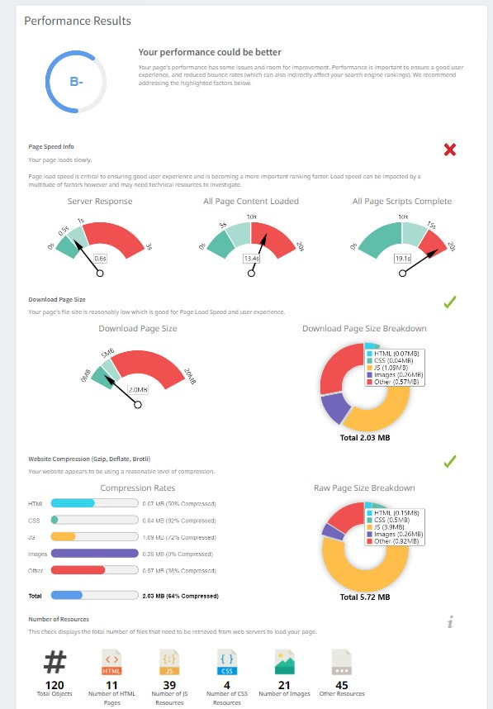
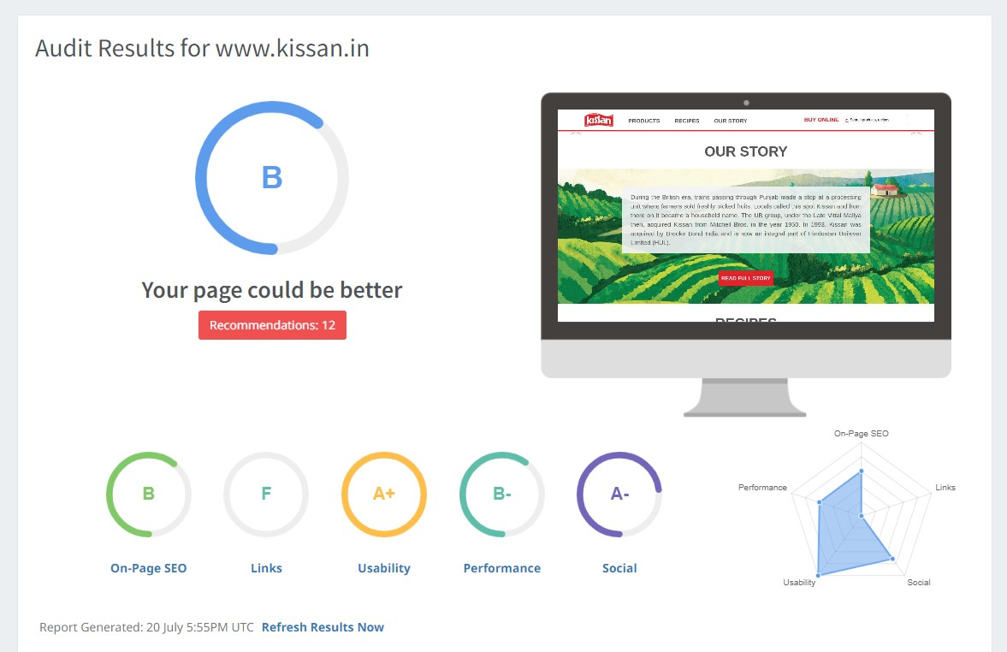
SEO Audit :
Video link : https://youtu.be/ix5PcBvYJ0s

Slide 13
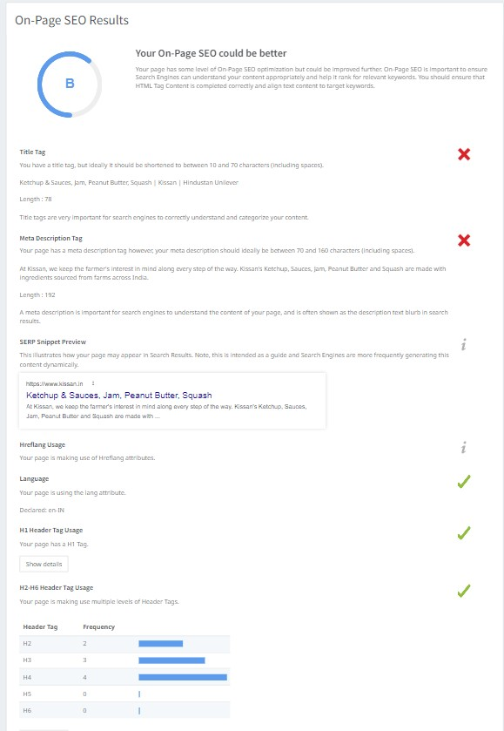
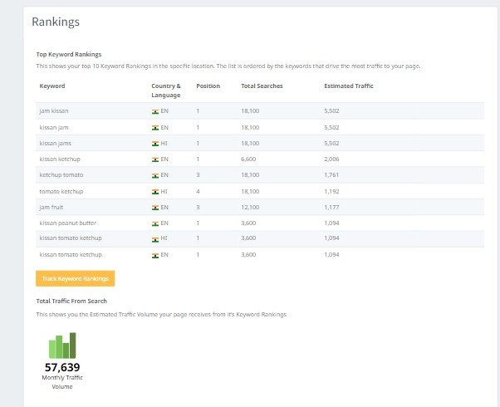

Slide 14
Research Objective : "To investigate the consumer perception and preferences towards natural and healthy fruit-based products, with a specific focus on Kissan's existing product range. The research aims to understand the factors influencing consumer choices, identify potential areas of improvement, and explore opportunities to enhance brand loyalty and market share in the competitive fruit-based products segment in India.“
Long-tail Keyword :
1. Target Audience: Health-conscious consumers
Long-tail Keywords
"Healthy snacks for kids by Kissan Ind Ltd"
"Nutritious food options from Kissan Ind Ltd"
"Low-sugar fruit jams Kissan Ind Ltd"
"Gluten-free sauces by Kissan Ind Ltd"
"Organic food products Kissan Ind Ltd"
"Vegan condiments by Kissan Ind Ltd"
"Best natural fruit preserves Kissan Ind Ltd"
"Kissan Ind Ltd clean label products"
"Non-GMO spreads by Kissan Ind Ltd"

Slide 15
Brainstorm Seed Keywords
Seed Keywords
Kissan
Kissan Ind Ltd
Kissan Industries
Kissan products
Food products
Jams
Sauces
Preserves
Fruit preserves
Beverages

Slide 16
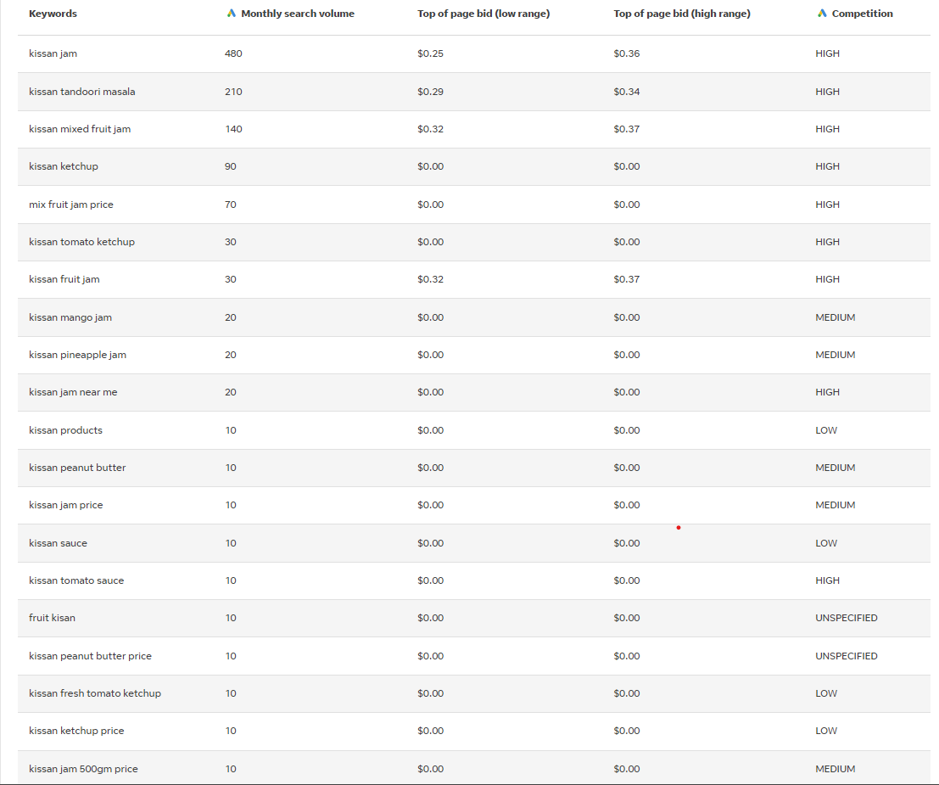
Keyword Research

Slide 17
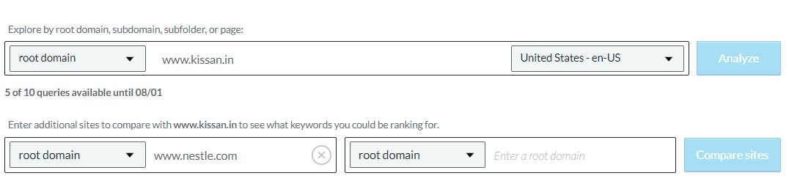
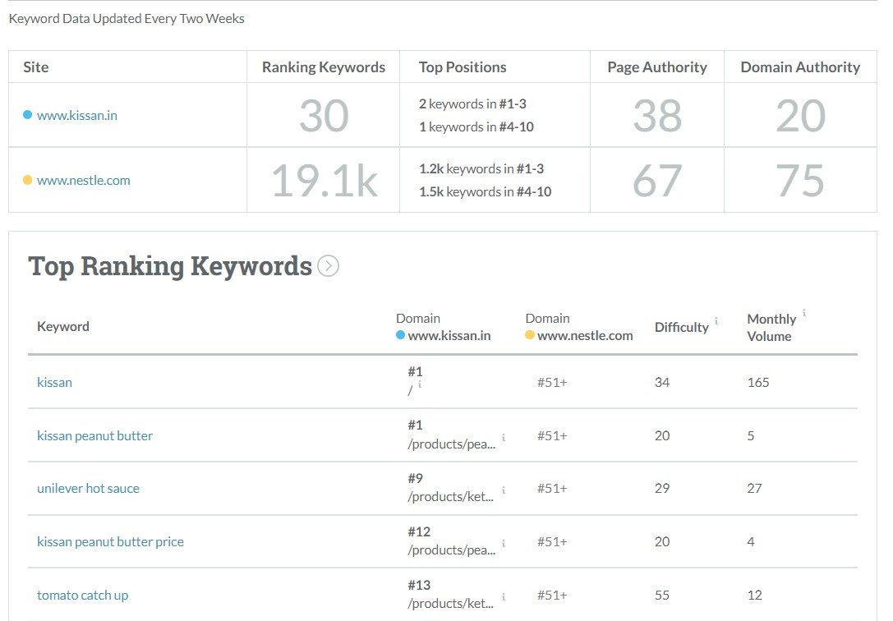
Analyze Competitor Keywords

Slide 18
On-Page Optimisation:
Meta Tag Optimization for www.kissan.in:
1.Title Tag :- Current Title Tag: "Kissan | Home"- Suggested Title Tag: "Kissan India - Bringing the Taste of Nature to Your Home | Home
2.Description Tag :- Current Description Tag: "Welcome to Kissan! Discover our wide range of jams, sauces, and spreads that will delight your taste buds. Explore recipes, get tips, and find out more about our products here.“
Suggested Description Tag: "Experience the delightful taste of nature at Kissan! Explore our diverse range of jams, sauces, and spreads that will satisfy your taste buds. Discover recipes, useful tips, and learn more about our premium products.“
3. Keywords Tag :- Suggested Keywords Tag: "Kissan, Jams, Sauces, Spreads, Nature-inspired, Recipes, Tasty, Premium Products.“
Content Optimization for www.kissan.in:*
Homepage:- Ensure the homepage displays an inviting and visually appealing design that reflects the brand's focus on nature-inspired products.Add a clear and prominent CTA to lead visitors to explore product categories or shop online. Highlight the brand's commitment to quality, taste, and freshness through brief and compelling content

Slide 19
2. Product Pages:- Each product page should have a unique and descriptive title that includes the product name and flavor/variant.Provide detailed product descriptions highlighting the unique features, natural ingredients, and taste experience.
3. Recipes and Tips Section:- Create a dedicated section for recipes and tips to inspire visitors on how to use Kissan products creatively.
4. About Us Page:- Provide a compelling "About Us" section that tells the story of Kissan, its heritage, and its commitment to natural and flavorful products.Include information about the brand's dedication to sourcing the finest ingredients and maintaining the highest quality standards.
5. Contact Page: Include essential contact details, such as a phone number, email address, and physical address.- Offer a customer support FAQ section to address common queries and concerns.
6. Mobile Responsiveness:- Ensure the website is fully responsive and mobile-friendly, providing a seamless experience across different devices.
7. SEO Best Practices:- Regularly update the website with fresh content, including new recipes, product launches, and blog posts to improve organic search visibility.Optimize images with alt tags and compress them to enhance page loading speed.Focus on creating shareable content to increase backlinks and social media engagement.

Slide 20
Part 3: Content Ideas and Marketing Strategies
Content Idea Generation & Strategy: Create a content calendar for the remaining month of July by brainstorming content themes, exploring various formats like blog posts, videos, infographics, podcasts, and interactive quizzes, and scheduling publication dates mainly on Facebook & Instagram. And include the strategy, aim and the idea behind these posts and story
Content Calendar Example (Try creating a table for the month of July)

Slide 21
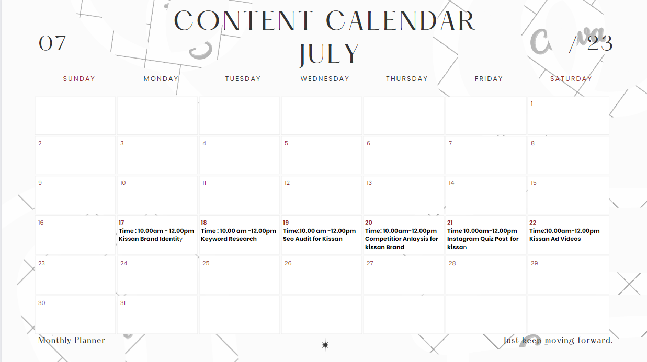
content calendar for month of july

Slide 22
Aim : After idea Kissan products revolve around enhancing and enriching consumers' lives through high-quality, natural, and innovative food offerings. With a mission to create delightful culinary experiences, Kissan focuses on using the freshest fruits and vegetables to craft a wide range of delicious and nutritious products.
Strategy : The marketing strategies process proposed for Kissan Jam is well-rounded and takes into account the importance of understanding the target audience. Utilizing social media and influencer collaborations can significantly increase the brand's visibility and engagement with consumers, especially considering the target audience includes families and individuals who are likely active on social platforms..
Idea behind the posts and story : Overall, the idea behind Kissan's posts and story is to create a brand identity that resonates with consumers on an emotional level. By connecting with their audience through shared experiences and values, Kissan establishes a strong and lasting relationship with its customers, ultimately leading to brand loyalty and continued success in the market.

Slide 23
Part 3: Content Ideas and Marketing Strategies
Reflect on the content ideas and marketing strategies process, discussing the challenges encountered and lessons learned.
Content Ideas and Marketing Strategy Process:
Understanding the Audience: The process begins with in-depth research to understand the target audience's preferences, pain points, and aspirations. This helps in tailoring content that resonates with their needs and interests.
Creativity and Innovation: Developing unique and creative content ideas that stand out in a saturated market is essential. It involves brainstorming sessions, collaboration among team members, and staying updated with current trends.

Slide 24
Brand Identity and Storytelling : Crafting a compelling brand story and identity is crucial for building an emotional connection with customers. Storytelling helps humanize the brand and makes it more relatable.
Multi-channel Approach : Implementing a multi-channel marketing approach ensures that the content reaches a broader audience. This includes leveraging social media, blogs, email marketing, videos, and more.
Data-Driven Decision Making : Analyzing data and insights from various marketing efforts helps in refining content strategies. This involves tracking metrics such as engagement, conversion rates, and customer feedback.
Challenges Encountered:
Content Overload : In a digital world, consumers are bombarded with content daily. Standing out and capturing their attention amid the content overload can be challenging.
Audience Fragmentation : Different audience segments have diverse preferences, making it difficult to create one-size-fits-all content. Personalization becomes crucial but requires more resources and effort.

Slide 25
Content Quality vs. Quantity : Balancing the need for consistent content production with maintaining high-quality standards can be a challenge.
Platform Algorithm Changes: Social media platforms often update their algorithms, affecting content reach and engagement. Staying adaptable to these changes is vital for success.
Lessons Learned:
Quality Over Quantity: Focus on producing high-quality content that adds value to the audience. Engaging and valuable content tends to have a more significant impact.
Customer-Centric Approach: Put the audience at the core of content creation and marketing strategies. Understanding their needs and preferences leads to more meaningful connections.
Agility and Flexibility: Embrace a flexible approach to adapt quickly to changing market trends and platform algorithm updates. This requires ongoing monitoring and evaluation.
Consistency and Patience: Building a strong brand presence and loyal customer base takes time. Consistent efforts and patience are necessary for long-term success.

Slide 26
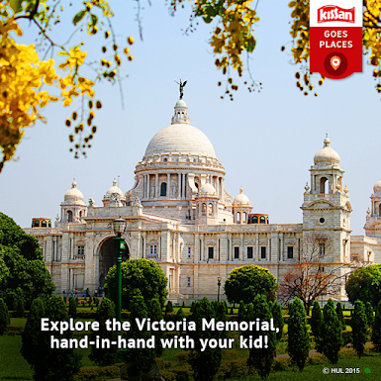
Part 4: Content Creation and Curation (Post creations, Designs/Video Editing, Ad Campaigns over Social Media and Email Ideation and Creation) Format 1: Blog article Aim : Boost Seo & provide information about major power distriburtion equipment manufacturer with a strong global presence Date : 20 July 2023 Blog link : www.kissanproducts.blogspot.com Post : You cannot leave the City of Joy without taking your little ones to the Victoria Memorial.

Slide 27
Part 4: Content Creation and Curation (Post creations, Designs/Video Editing, Ad Campaigns over Social Media and Email Ideation and Creation)
Format 2 : Video
Topic :5 –must try products for breakfast, lunch & dinner
Date : 21 July 2023
Video Link : https://youtu.be/cjYRWCS7nJk

Slide 28
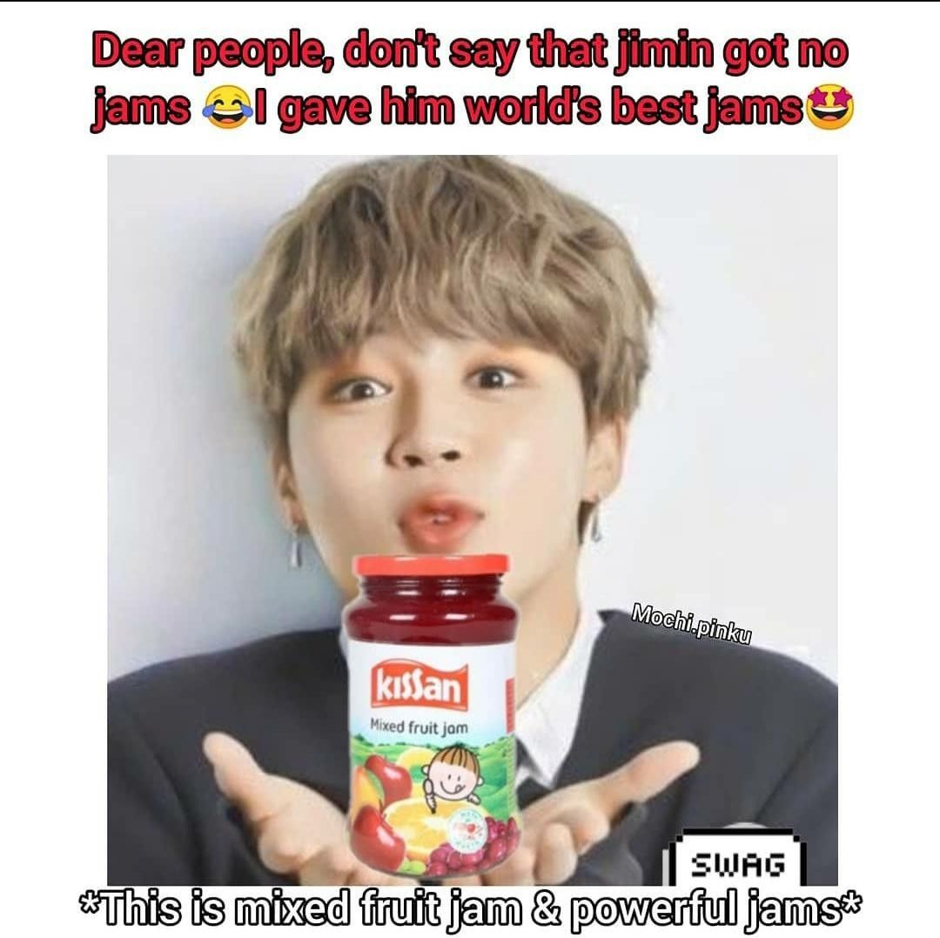
Part 4: Content Creation and Curation (Post creations, Designs/Video Editing, Ad Campaigns over Social Media and Email Ideation and Creation)
Format 3: Creative
Aim : Brand awareness & reach
Date : 22nd July 2023
Topic : Kissan Jam
Meme :

Slide 29
Part 4: Content Creation and Curation (Post creations, Designs/Video Editing, Ad Campaigns over Social Media and Email Ideation and Creation)
Instagram Story
Utilize the Stories feature on Instagram for three consecutive days. Share behind-the-scenes glimpses, polls, quizzes, or sneak peeks etc to encourage audience participation. Once uploaded use the story highlight feature on Instagram and save the 3 story with an appropriate name for each. Note: Once done monitor the performance of the posts and Stories using the insight tool and analyze the engagement metrics (likes, comments, shares, impressions, etc.). Based on the analysis, mention the strategies and areas for improvement.

Slide 30
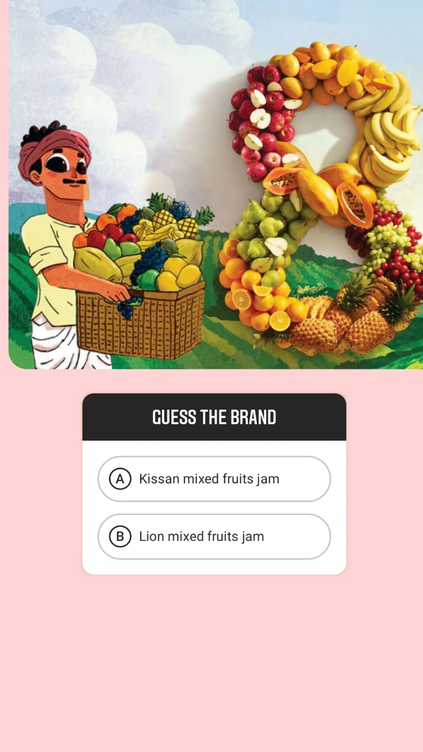
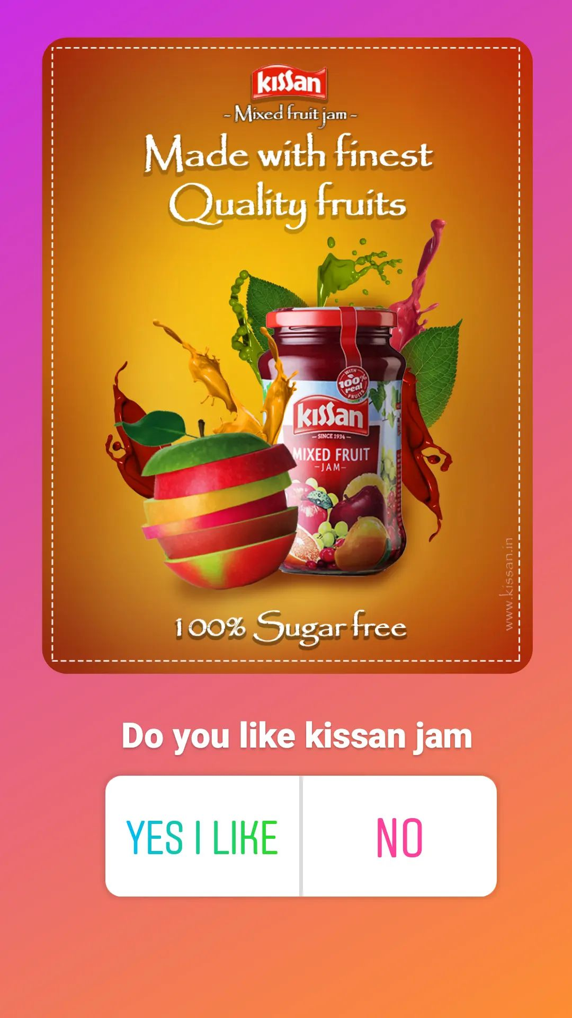
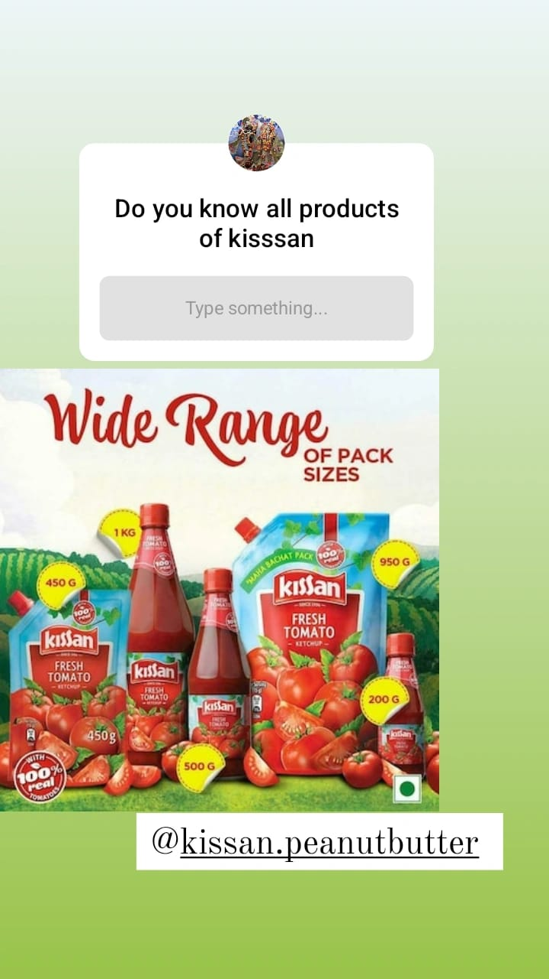

Slide 31
Part 4: Content Creation and Curation (Post creations, Designs/Video Editing, Ad Campaigns over Social Media and Email Ideation and Creation)
Designs/Video Editing
Design Tools Familiarization (use Canva for creating visually appealing graphics)
Video Creation: Utilize VN or any video editor of your choice to create videos related to the chosen topic.
The UB group, under the Late Vittal Mallya then, acquired Kissan from Mitchell Bros. in the year 1950. In 1993, Kissan was acquired by Brooke Bond India and is now an integral part of Hindustan Unilever Limited (HUL)
KISSAN AD VIDEO LINK :
https://youtu.be/cjYRWCS7nJk
By using canva and video editing apps are used to develop the video for kissan add and uploaded in different platforms to reach them

Slide 32
MAKING THE VIDEO FOR KISSAN ADD
The video production process consist of three main steps
Pre-production in which planning stage for mapping out your strategy and script for the video, production is the phase in which the video is shot, and finally post production, which involves editing the video , adding music and other effects.Lets walk through the process step by step.
Firstly collect information about kissan through official websites of kissan
Secondly collect images and other details about them and ready to plan the process
Thirdly from the collected data, make the video by using editing app sites

Slide 33
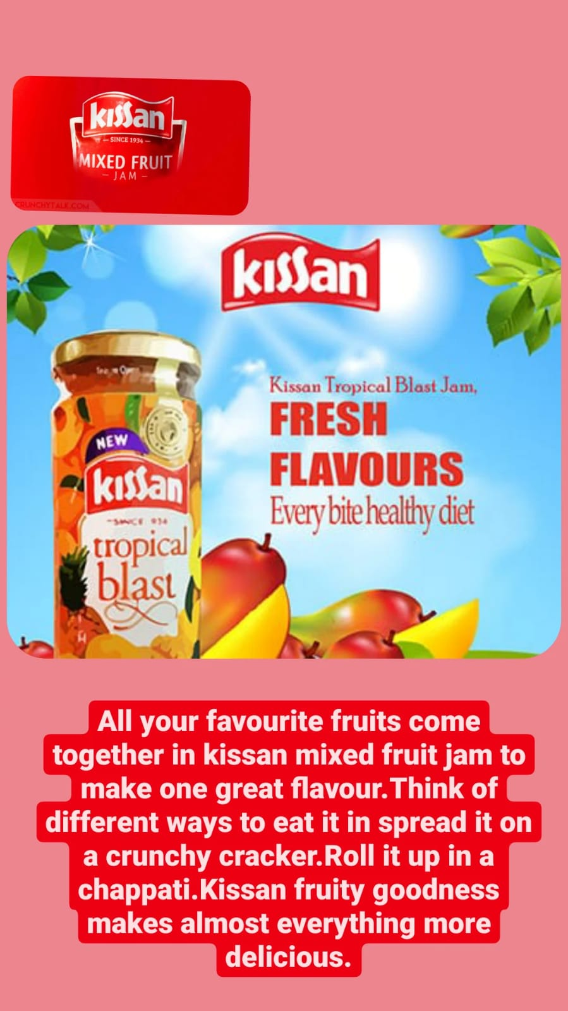
Part 4: Content Creation and Curation (Post creations, Designs/Video Editing, Ad Campaigns over Social Media and Email Ideation and Creation)
Social Media Ad Campaigns
Brandwareness :What makes your brand unique? Establish what makes Kissan Jam special with clarity and create a captivating brand narrative.
Determine the essential qualities and principles of the product that appeal to your target market.Use well-known social media sites like Facebook, Instagram, Twitter, and YouTube to promote your company by engaging in social media marketing.
Share interesting information with your audience, such as user-generated content, recipes, serving ideas, and behind-the-scenes looks at the production process.

Slide 34
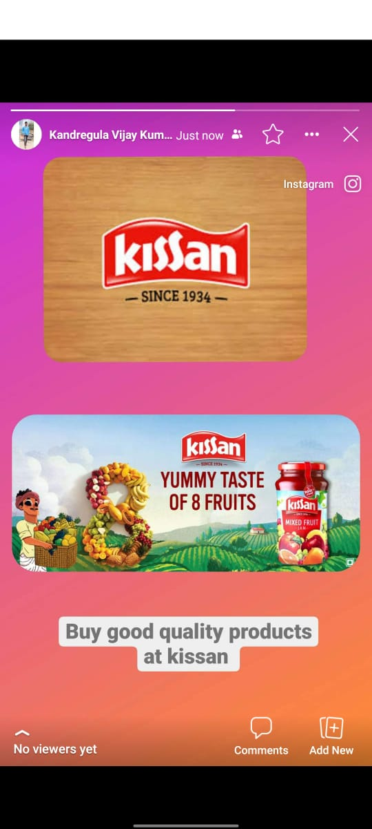
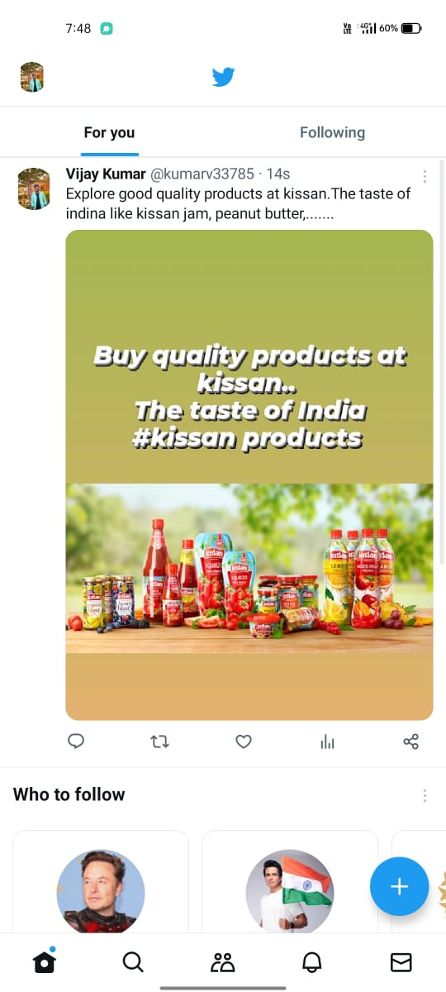
Website:www.kissanjam.in
Driving website traffic:Kissan Jam or any other product can be effectively promoted through social media advertising. The following steps will show you how to make a fruitful social media marketing campaign for Kissan .
Identify Your Target Market: Decide who Kissan Jam's ideal customer is. Think about your internet activities, interests, and demographics. This will assist you in producing targeted advertisements that appeal to your audience.
Select the Correct Social Media Platforms: Decide which social media sites are most used by your target demographic. Popular choices include Facebook, Instagram, Twitter, and YouTube.
Remember to maintain a consistent brand voice, stay authentic, and engage with users genuinely to create a memorable and successful Twitter campaign for Kissan products.
"Discover the delightful taste and wholesome goodness of Kissan products – making every meal a delightful experience! 🍅🥗 #KissanDelights"

Slide 35
Part 4: Content Creation and Curation (Post creations, Designs/Video Editing, Ad Campaigns over Social Media and Email Ideation and Creation)
For every campaign clearly define:
Advertising Goals: increasing brand awareness, driving website traffic, or generating leads.
Audience Targeting: Define the target audience for the ad campaigns based on demographics, interests, and behavior.
Ad Creation: Create visually appealing ad creatives, compelling ad copy and relevant call-to-action.

Slide 36
Part 4: Content Creation and Curation (Post creations, Designs/Video Editing, Ad Campaigns over Social Media and Email Ideation and Creation)
Email Ad Campaigns
Ad Campaigns for email marketing:
Brand Awareness: Brand awareness refers to the extent to which consumers recognize and recall a particular brand. It is a crucial marketing metric that reflects the brand's visibility, familiarity, and recall among the target audience. Building strong brand awareness helps increase customer trust, loyalty, and preference for the brand's products or services.
Lead generation: Lead generation is the process of attracting and capturing potential customers (leads) who show interest in a company's products or services. It involves various marketing strategies, such as content marketing, social media, and email campaigns, to generate interest and collect contact information for follow-up and conversion into paying customers.

Slide 37
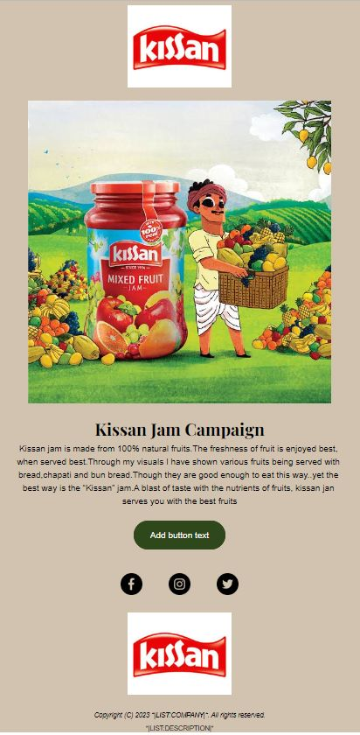
Email Ad Campaign 1 - Brand Awareness
(insert emailer image)

Slide 38
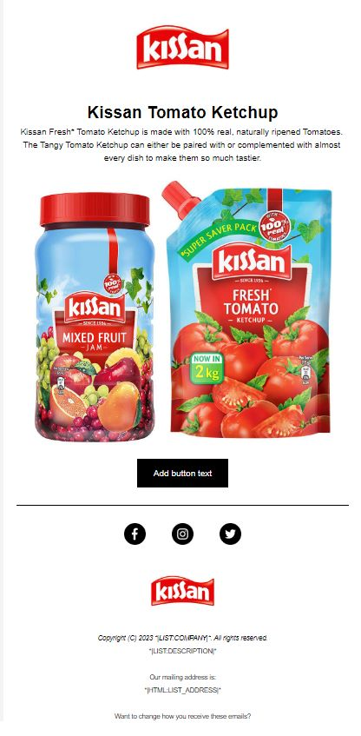
Email Ad Campaign 2 - Lead Generation
(insert emailer image)

Slide 39
Part 4: Content Creation and Curation (Post creations, Designs/Video
Editing, Ad Campaigns over Social Media and Email Ideation and Creation)
Reflect on the content creation and curation process, discussing the challenges faced and lessons learned.
Challenges for Kissan products:Standing out in a competitive market saturated with other food brands.
Effectively conveying health and taste benefits to consumers.
Addressing customer preferences and staying in tune with changing trends.
Adapting to digital platforms for wider reach while maintaining brand identity.
Balancing creativity with brand guidelines and messaging consistency.
Benefits of content curation include :
Time and cost-saving by leveraging existing content.
Enhanced credibility through diverse perspectives and expert insights.
Building authority as a trusted source of curated content.
Increased engagement and brand loyalty by providing valuable and relevant information

